Slide 1







Session 110: Disentangling human from natural factors: Taphonomical value of microanatomical features on archaeological wood and charcoal assemblages
INTRODUCTION
Paloma Vidal Matutano^{1,2}, Auréade Henry¹, Yolanda Carrion², Ethel Allué³
¹ CEPAM UMR 7264 CNRS, Université Côte d’Azur, Nice
² Universitat de Valencia, Spain
³ Institut Catala de Paleoecologia, Tarragona, Spain

Slide 2

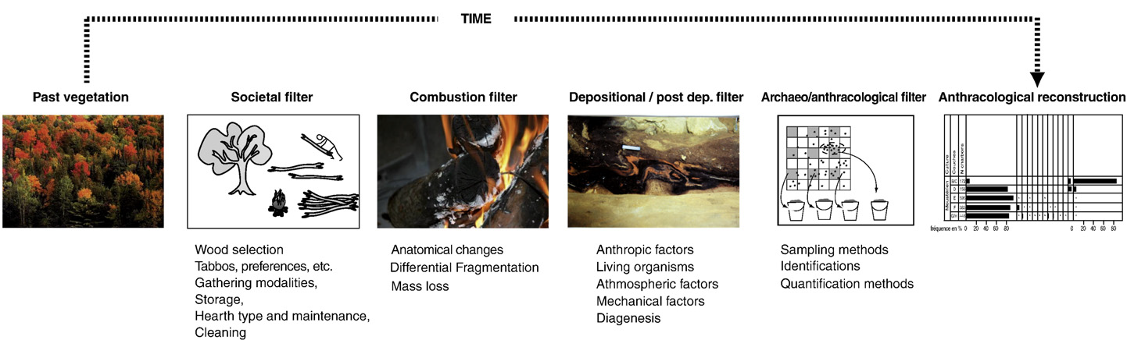
Session 110: Disentangling human from natural factors: Taphonomical value of microanatomical features on archaeological wood and charcoal assemblages
École de Montpellier
Palaeoecological representativeness
1st methodological approach
Which taphonomic processes affect the anthracological assemblages?
Human activities
Natural processes
(Théry-Parisot et al. 2010)

Slide 3
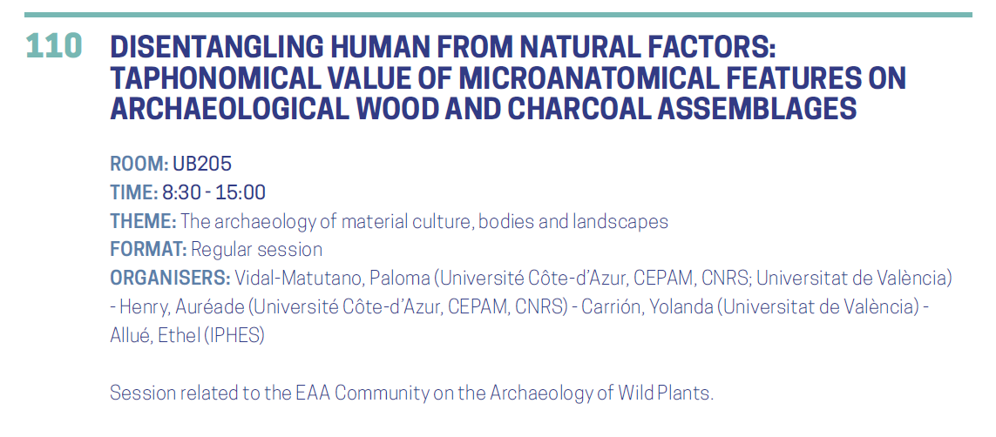
Session 110: Disentangling human from natural factors: Taphonomical value of microanatomical features on archaeological wood and charcoal assemblages
12 oral communications + 1 poster
15-minute presentation
The last 5 - 2 minutes of each presentation will be indicated
2 minute question slots, but Discussion slot at 12.15

Slide 4
Session 110: Disentangling human from natural factors: Taphonomical value of microanatomical features on archaeological wood and charcoal assemblages
TIME
MAIN AUTHOR
TITLE
8.45
9.00
9.15
9.30
9.45
10.00
10.15
A. Arranz
E. Allué
R. Piqué
M.-A. Courty
A. Henry
P. Vidal
M. Alcolea
How the recovery methods affect the representation of wood charcoal assemblages: a taphonomic approach
The meaning of charcoal taphonomical markers values in Palaeolihic Pinus sylvestris type assemblages from the NE of Iberia
Experimental charring of degraded and healthy wood for understanding firewood acquisition in prehistoric societies
Forming mechanisms, environmental relevance and cultural implications of vitrified charcoal
When experimentation raises more questions than it provides answers: laboratory replication of vitrified wood charcoal and its relevance for archaeology
Spatial analysis of vitrified charcoal fragments from Chasogo (Tenerife, Canary Islands): A methodological approach
Pinewoods and vitrification high-levels in Mesolithic charcoal assemblages in the Ebro valley (Iberian Peninsula). A specific use or limited availability?

Slide 5
Session 110: Disentangling human from natural factors: Taphonomical value of microanatomical features on archaeological wood and charcoal assemblages
TIME
MAIN AUTHOR
TITLE
10.30
COFFEE BREAK
11.00
11.15
11.30
11.45
12.00
12.15
Y. Carrión
K. Peseckas
R. Santeramo
S. Paradis-Grenouillet
E. Ponomarenko
Influence of occupation and sedimentation patterns on charcoal bioalteration at Abrigo de la Quebrada (Valencia, Spain)
Analysis of accidently collected charcoals from cremated graves. Case study of Iron Age Marvele cemetery and Dubingiai burial mounds
Growth ring curvatures, a tool to understand depositional processes?
Estimating plant height from anatomical traits of archaeological wood and charcoal remains
Diagnostic features of the charcoal assemblages associated with the swidden cultivation
DISCUSSION

Slide 6
Session 110: Disentangling human from natural factors: Taphonomical value of microanatomical features on archaeological wood and charcoal assemblages
EAA Session 110 publication opportunities
Submission of a proposal to QI or JAS: Reports
Until September 30th: interested authors with preliminary title of the paper
paloma.vidal@uv.es

